Slide 1

Avance del proyecto 2: Análisis y diseño de la solución

Slide 2

¡HOLA!
Nosotros somos A’Bak
Irving Alain Aguilar Pérez
Javier Méndez Martínez
Emmanuel Antonio Ramírez Herrera
Alonso Oropeza Arévalo

Slide 3
Nuestro proyecto
-CBTis 145
-Seguimiento a alumnos egresados
-Apoyo para la toma de decisiones
-Centralización de información

Slide 4
ANTECEDENTES
Lo que fue el primer avance...

Slide 6
REQUISITOS FUNCIONALES

Slide 7
Requisitos funcionales
Here you have a list of items
And some text
But remember not to overload your slides with content
Your audience will listen to you or read the content, but won’t do both.

Slide 8
REGLAS DE NEGOCIO

Slide 9
REQUISITOS NO FUNCIONALES

Slide 10
Reglas de negocio
Here you have a list of items
And some text
But remember not to overload your slides with content
Your audience will listen to you or read the content, but won’t do both.

Slide 11
MODELO ENTIDAD-RELACIÓN

Slide 12
Modelo Entidad-Relación
Here you have a list of items
And some text
But remember not to overload your slides with content
Your audience will listen to you or read the content, but won’t do both.

Slide 13
DICCIONARIO DE DATOS

Slide 14
Diccionario de datos
Here you have a list of items
And some text
But remember not to overload your slides with content
Your audience will listen to you or read the content, but won’t do both.

Slide 15
DOCUMENTACIÓN DE RESTRICCIONES ADICIONALES

Slide 16
Documentación de restricciones adicionales
Here you have a list of items
And some text
But remember not to overload your slides with content
Your audience will listen to you or read the content, but won’t do both.

Slide 17
MODELO RELACIONAL

Slide 18
Modelo relacional
Here you have a list of items
And some text
But remember not to overload your slides with content
Your audience will listen to you or read the content, but won’t do both.

Slide 19
MAPA DEL SITIO

Slide 20
INTERFAZ DE USUARIO

Slide 21
PLAN DE COMUNICACIÓN

Slide 22
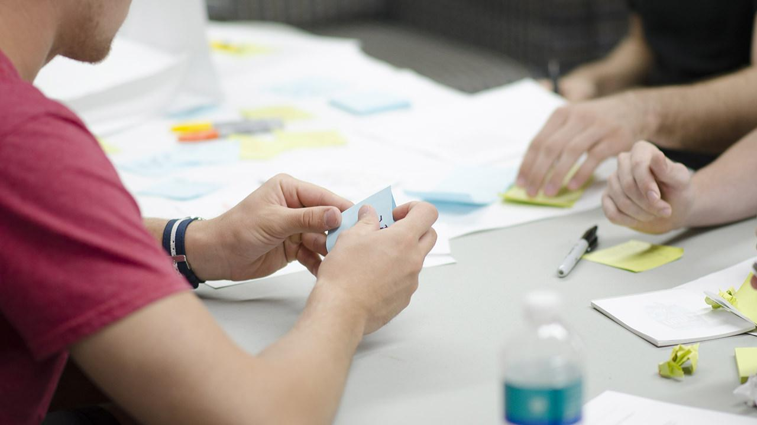
A picture is worth a thousand words
A complex idea can be conveyed with just a single still image, namely making it possible to absorb large amounts of data quickly.

Slide 23

Want big impact? USE BIG IMAGE

Slide 24
Use charts to explain your ideas
White
Gray
Black

Slide 25
And tables to compare data
 | A | B | C
Yellow | 10 | 20 | 7
Blue | 30 | 15 | 10
Orange | 5 | 24 | 16

Slide 26
89,526,124
Whoa! That’s a big number, aren’t you proud?

Slide 27
89,526,124$
185,244 users
100%
That’s a lot of money
And a lot of users
Total success!

Slide 28
Our process is easy
first
second
last

Slide 29
Let’s review some concepts
Yellow
Is the color of gold, butter and ripe lemons. In the spectrum of visible light, yellow is found between green and orange.
Blue
Is the colour of the clear sky and the deep sea. It is located between violet and green on the optical spectrum.
Red
Is the color of blood, and because of this it has historically been associated with sacrifice, danger and courage.
Yellow
Is the color of gold, butter and ripe lemons. In the spectrum of visible light, yellow is found between green and orange.
Blue
Is the colour of the clear sky and the deep sea. It is located between violet and green on the optical spectrum.
Red
Is the color of blood, and because of this it has historically been associated with sacrifice, danger and courage.

Slide 30
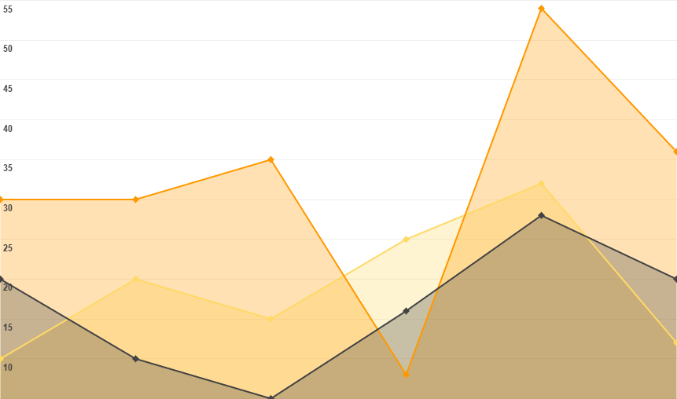
You can insert graphs from Google Sheets

Slide 31
ANDROID PROJECT
Show and explain your web, app or software projects using these gadget templates.
Place your screenshot here

Slide 32
iPHONE
PROJECT
Show and explain your web, app or software projects using these gadget templates.
Place your screenshot here

Slide 33
TABLET
PROJECT
Show and explain your web, app or software projects using these gadget templates.
Place your screenshot here

Slide 34
DESKTOP PROJECT
Show and explain your web, app or software projects using these gadget templates.
Place your screenshot here

Slide 35
¡GRACIAS!
Visítanos 😉
irvingpercam.github.io/daw

Slide 36
Credits
Special thanks to all the people who made and released these awesome resources for free:
Presentation template by SlidesCarnival
Photographs by Startupstockphotos

Slide 37
Presentation design
This presentation uses the following typographies and colors:
Titles: Dosis
Body copy: Roboto
You can download the fonts on these pages:
https://www.fontsquirrel.com/fonts/dosis
https://material.google.com/resources/roboto-noto-fonts.html
Orange #ff8700
You don’t need to keep this slide in your presentation. It’s only here to serve you as a design guide if you need to create new slides or download the fonts to edit the presentation in PowerPoint®

Slide 38
SlidesCarnival icons are editable shapes.
This means that you can:
Resize them without losing quality.
Change line color, width and style.
Isn’t that nice? :)
Examples:

Slide 39
😉
Now you can use any emoji as an icon!
And of course it resizes without losing quality and you can change the color.
How? Follow Google instructions https://twitter.com/googledocs/status/730087240156643328
✋👆👉👍👤👦👧👨👩👪💃🏃💑❤😂😉😋😒😭👶😸🐟🍒🍔💣📌📖🔨🎃🎈🎨🏈🏰🌏🔌🔑 and many more...

